Slide 1
Thyroid Disease Classification

Slide 2
CONTENTS
Data Overview | The Thyroid Disease dataset is a collection of data on patients with thyroid disease. The data was collected from two medical centers in Germany and contains information on 3,772 patients.
Cleaning & Preprocessing | One Dataset from one centre
Exploring Data Analysis | Answering Business questions?!!!
Scaling & imbalance Data | Robust scaling and under sampling methods
Modeling & evaluation | Use several models to get the best accuracy .
Deployment | Classification problem classify thyroid stages.

Slide 3
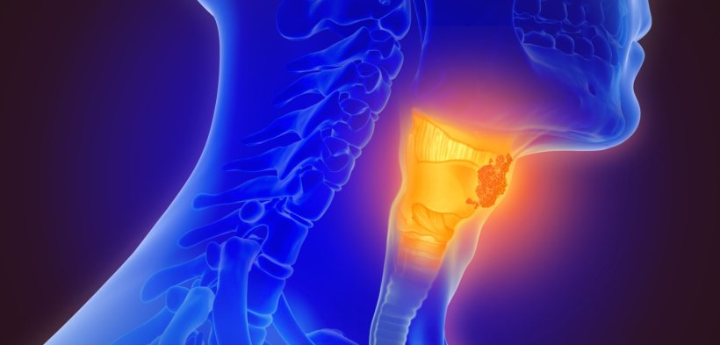
INTRODUCTION
The target variable in the Thyroid Disease dataset is the diagnosis of thyroid disease for each patient. The diagnosis can be one of three possible classes: hypothyroidism, hyperthyroidism, or euthyroidism (normal thyroid function).
The goal of this dataset is to predict the diagnosis of thyroid disease based on the available features, which include demographic information, thyroid hormone levels, and diagnostic information

Slide 4
Impact of thyroid diseases
Thyroid diseases have a significant impact on the population, affecting millions worldwide. They can lead to various health complications, including metabolic disorders, cardiovascular issues, and reproductive difficulties.
Proper diagnosis, treatment, and management are crucial for mitigating the impact of thyroid diseases on individuals' health and well-being.

Slide 5
01
Cleaning & preprocessing

Slide 6

Concatenate csv files data
Building structure
3772 entries, 0 to 3771
Data columns (total 30 columns): all are of data type object.

Slide 7
Main Steps :
01
02
03
Drop missing values
Drop unnessesary columns
Handling inconsistent values
Handling categorical and numeric values using functions
Detecting outliers
Handling columns data types

Slide 8
Prepare for modeling
Encoding Target (y)
Categorical
Scaling
with
Handling
using
Mapping function
Get dummies & OneHotEncoder
Robust scaler

Slide 9
Continue ..Project steps
Handling imbalance
Feature selection
modeling
ADASYN - TomekLinks
Randomforest classifier
Cross validation
Hyper patameter tunning
3772
22
Random search cv
Modeling with out cv
deployment
Best evaluation
100%Best parameters: {'Model__n_estimators': 200, 'Model__max_depth': 5, 'Model__learning_rate': 0.5}
Gradient Boosting best 100% accuracy
Gradient model
Pipeline with 100 % acc.

Slide 10
Models' evaluation
Model name | f1-score | accuracy
Decision Tree | 0 ------ 100 % 1 ------ 96 % 2 ------ 100 % | 100 %
Random Forest | 0 ------ 100 % 1 ------ 97 % 2 ------ 100 % | 100 %
AdaBoost | 0 ------ 100 % 1 ------ 99 % 2 ------ 95 % | 100 %
Gradient Boosting | 0 ------ 100 % 1 ------ 99 % 2 ------ 100 % | 100 %

Slide 11
Evaluation Cross validation &hyperprameter tuning
GradientBoosting classifier
GB Model
cross validation (f1_score)
0.1
cv
Hyper tuning
100%Best parameters: {'Model__n_estimators': 200, 'Model__max_depth': 5, 'Model__learning_rate': 0.5}
(max_depth= 5), n_estim. = 200,learning rate = 0.5
Best model
Class 0 1.00
Class 1 0.99
Class 2 0.95

Slide 12
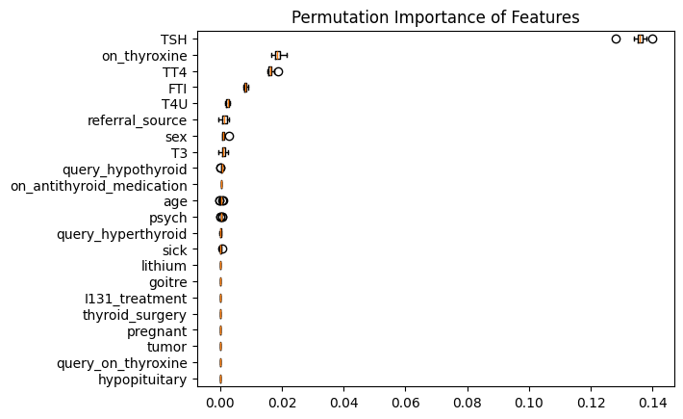
Feature Importance

Slide 13
EDA questions?

Slide 14
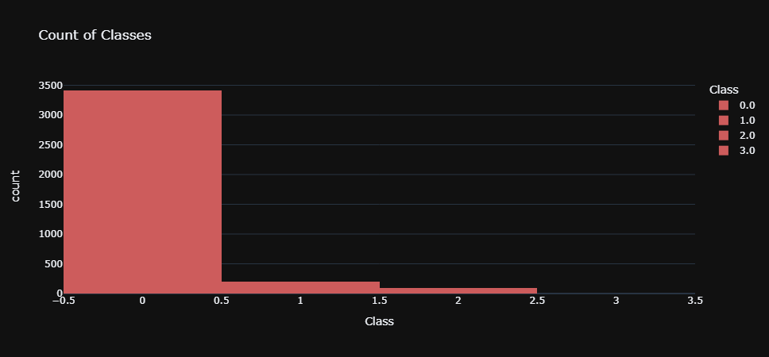
Number of buildings in each grade of damage.
Class 0 has the greatest number of patients in the dataset

Slide 15

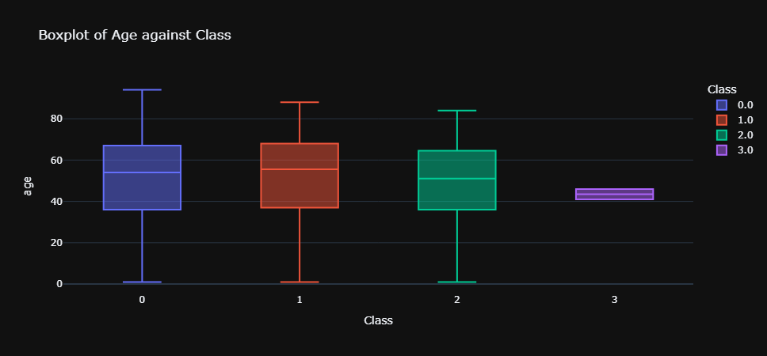




Class -VS Age
Patients with negative class has the maximum age in the dataset.

Slide 16
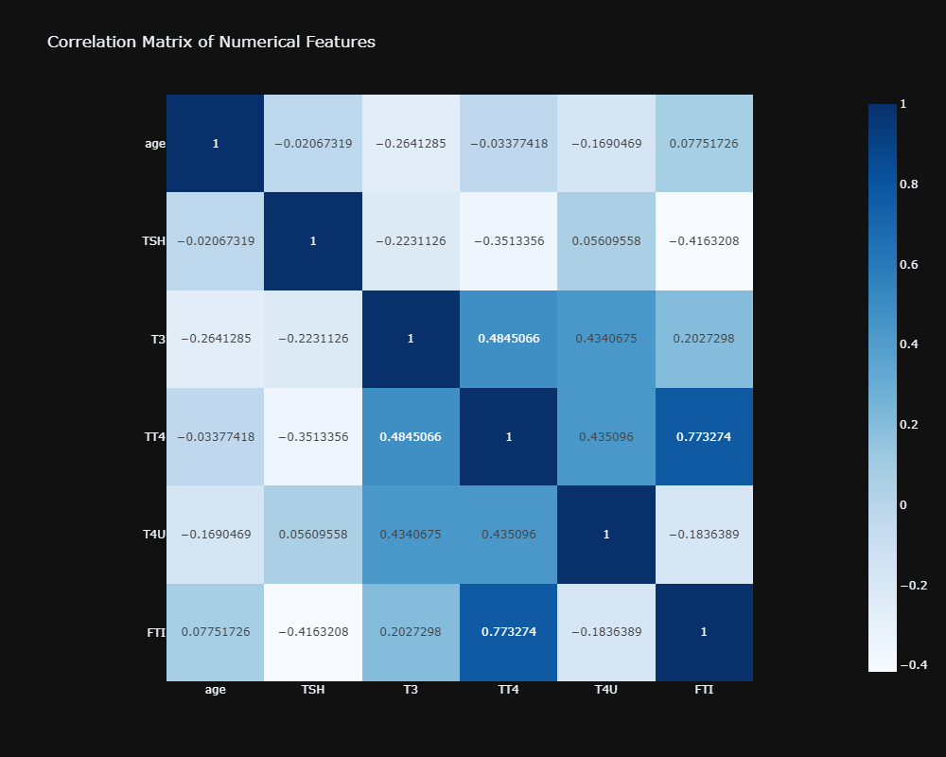
Correlation matrix of num. columns.
There is multicollinearity between some features. TT4 has 18.450318
FTI has 14.943144

Slide 17
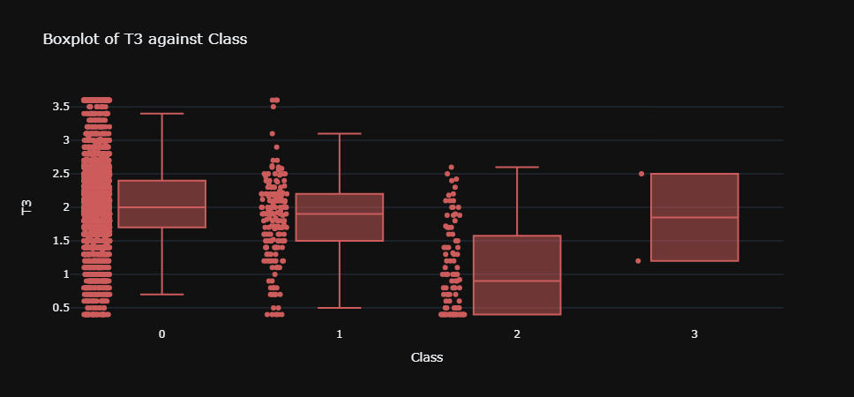
T3 vs class

Slide 18
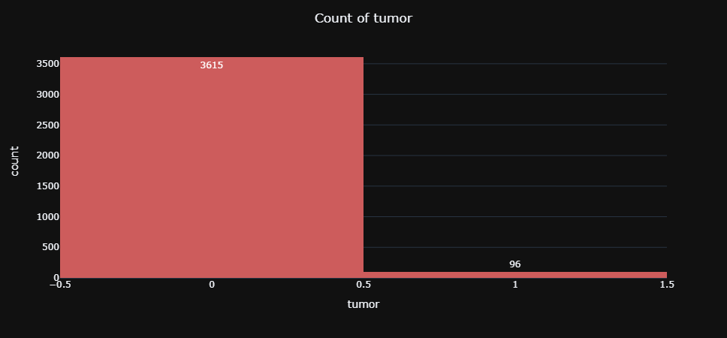
Tumor count
We can see that most of patients have positive tumor cases

Slide 19
Chi square test summary
Chi-square Test Results Summary
- Rejected Null Hypothesis: Sex, on_thyroxine, query_hypothyroid, referral_source_SVHC, and referral_source_SVI.
- Failed to Reject Null Hypothesis: Query_on_thyroxine, on_antithyroid_medication, sick, pregnant, thyroid_surgery, I131_treatment, query_hyperthyroid, lithium, goitre, tumor, hypopituitary, psych, referral_source_SVHD, and referral_source_other.
Interpretation:
- Features with Rejected Null Hypothesis:
Significant relationship with the 'Class' variable, suggesting their importance in predicting class outcomes.

Slide 20
Deployment
background
Using Streamlit
Thyroid disease prevelance
Personal info
Patients info
prediction
About Thyroid diseases
About all Thyroid gland markers - Demographics
What type of thyroid grade ?

Slide 21
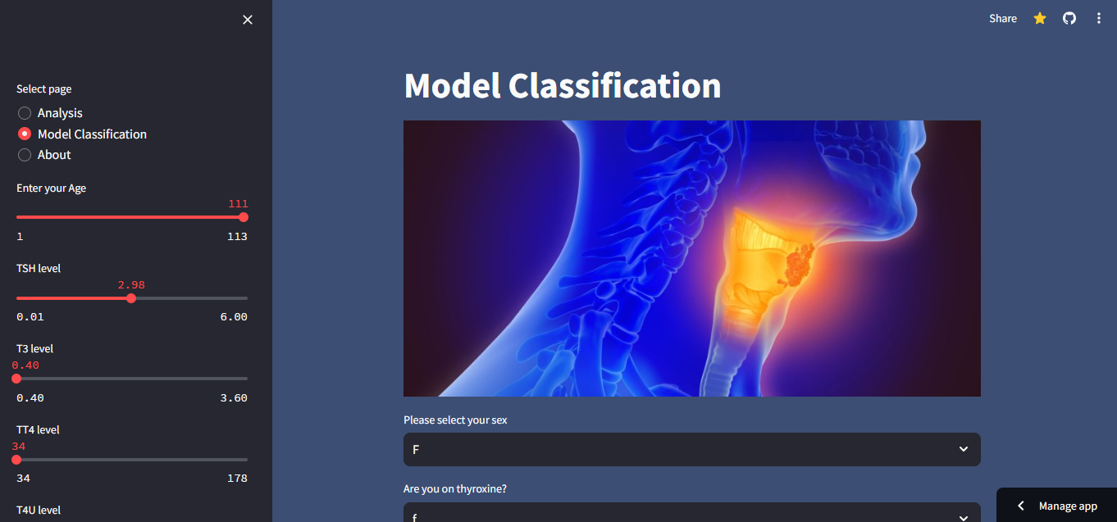

Slide 22
THANKS!

